Slide 1

Agentic RAG Chatbot
Empowering users to interact with their documents like never before.

Slide 2
Bridging the Information Gap
Problem Statement
Solution Overview
Users struggle to extract precise information from lengthy documents, leading to time-consuming manual searches and inefficient data retrieval.
An AI-powered chatbot that enables natural language querying of uploaded documents, delivering accurate answers with direct source references.
Difficulty in pinpointing specific answers.
Retrieval-Augmented Generation (RAG) approach.
Lack of immediate source verification.
Answers grounded strictly in document content.
Intuitive, animated user interface.

Slide 3




Agent-Based Architecture
Leveraging LangChain for modular and efficient processing.
Ingestion Agent
Responsible for parsing and preparing documents.
Retrieval Agent
Identifies and extracts relevant document chunks.
LLM Response Agent
Generates answers based on retrieved content.
This modular design, enhanced with Message Passing (MCP) for seamless communication, ensures robust and scalable performance.

Slide 4
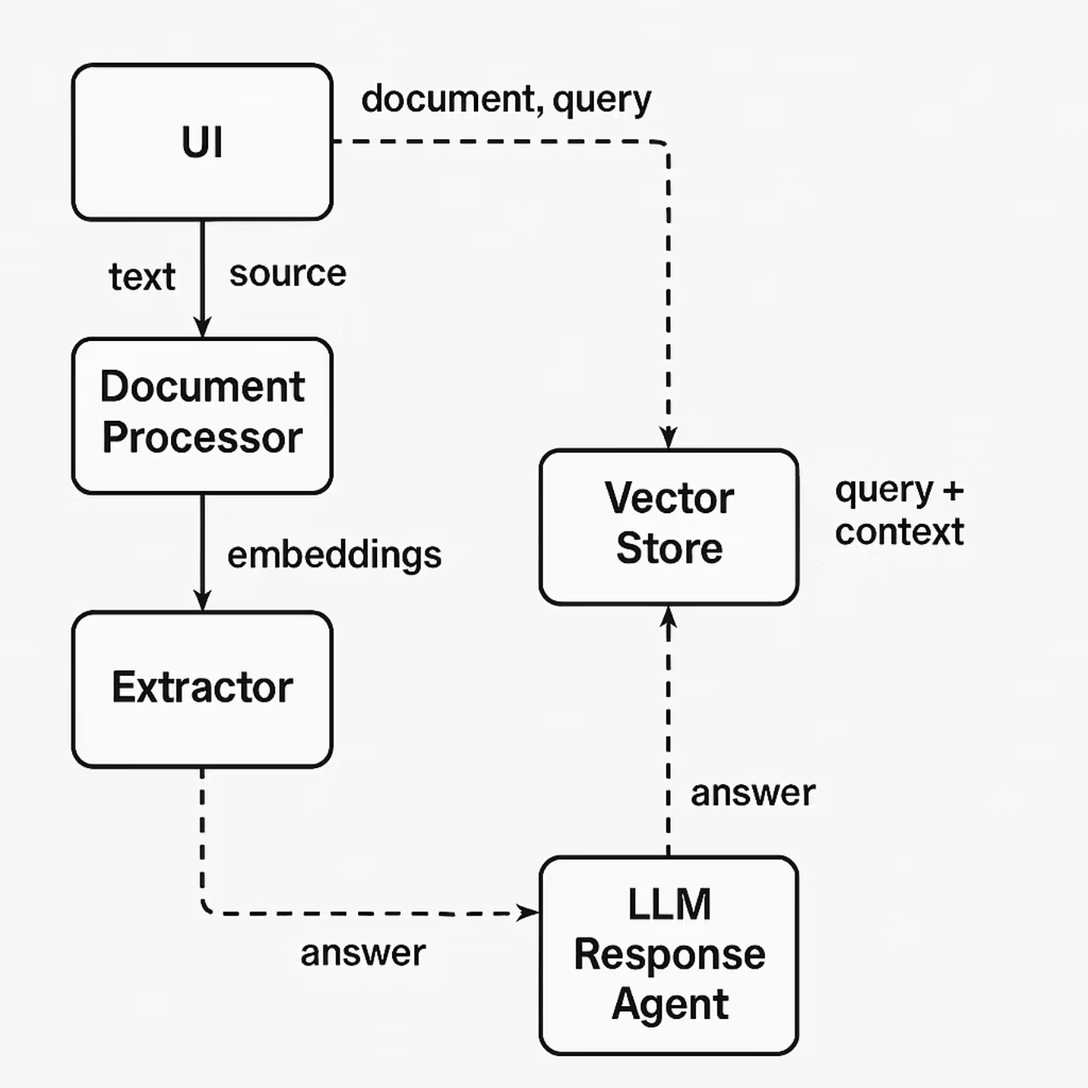
The Engine Behind the Intelligence
Tech stacks used
System flow diagram
Frontend: HTML, CSS (animated), JS, Jinja (Flask)
Backend: Python, Flask
AI: LangChain + GPT-3.5 via OpenAI
Vector Store: FAISS + OpenAIEmbeddings
Document Parsing: PyMuPDF, pdf2image, pytesseract, docx2txt, unstructured

Slide 5
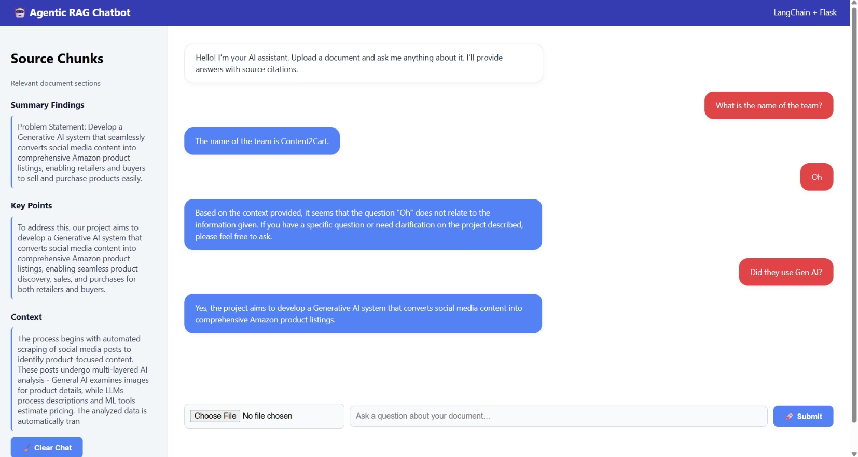
Seamless Workflow & Output Example
User Workflow
Example Interaction
Upload scanned or digital file.
Question: What is the name of the team?
Ask a question about the document.
Answer: The name of the team is Content2Cart.
LangChain parses, indexes, and retrieves relevant chunks.
Source: From uploaded file
LLM generates an answer, showing source chunks.
Final response displayed on the same page.

Slide 6
Next Steps & Acknowledgements
Future Enhancements
Web deployment for broader accessibility.
Integration of history/memory support for continuous conversations.
Powered by: OpenAI + LangChain
Upgrade to GPT-4 for even smarter and more nuanced answers.
Thank you for your time.

